Slide 1

CS4225/CS5425 Big Data Systems for Data Science
Graphs and PageRank
Ai Xin
School of Computing
National University of Singapore
aixin@comp.nus.edu.sg

Slide 2
Today’s Plan
Graphs: Introduction
Simplified PageRank
Flow Formulation
Random Walk Formulation
PageRank with Teleports
Topic Sensitive PageRank
PageRank Implementation

Slide 3
Graph Data
Nodes (e.g. people)
Edges represent relationships

Slide 4
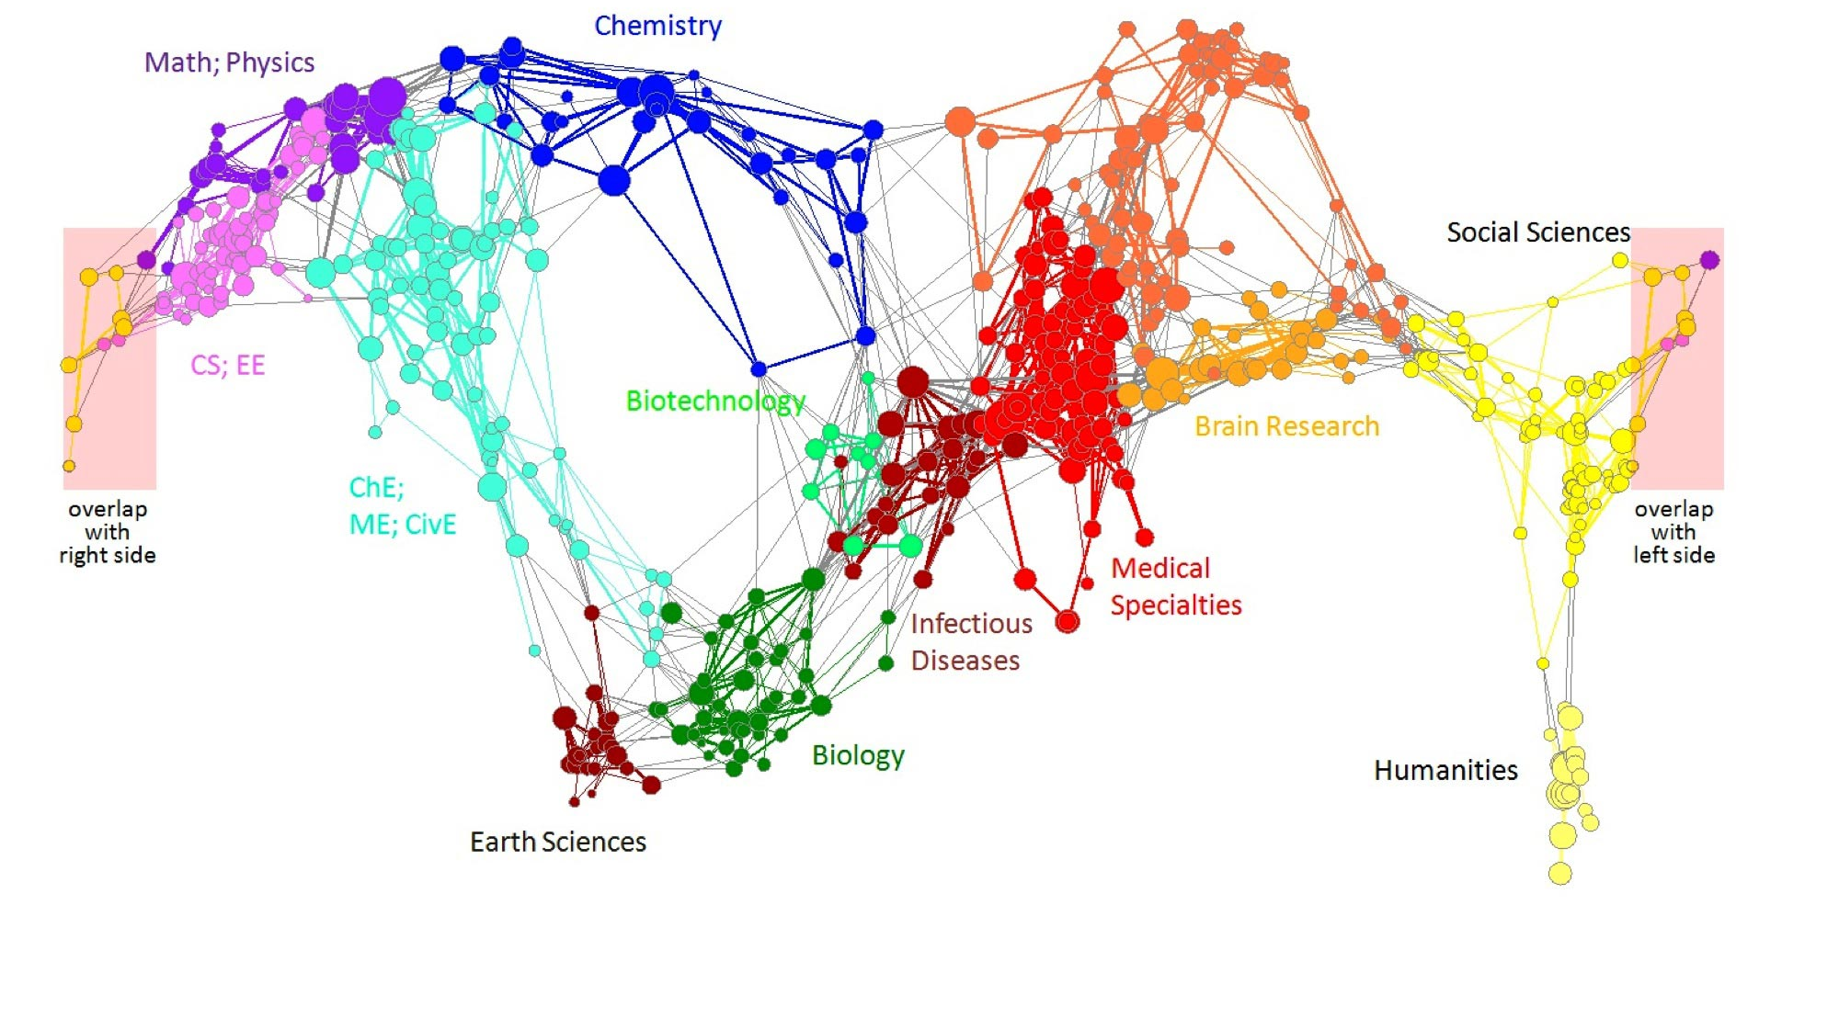
Graph Data: Information Networks
Edges represent relationships (in this case, citations)
- Can be undirected (e.g. friendship) or directed (e.g. citations, webpage hyperlinks)
Nodes represent objects (in this case, journals)
Citation networks and Maps of science
[Börner et al., 2012]
Notes:
http://www.eigenfactor.org/map/maps.php
An arrow from field A to field B indicates citation traffic from A to B, with larger, darker arrows indicating higher citation volume.

Slide 5
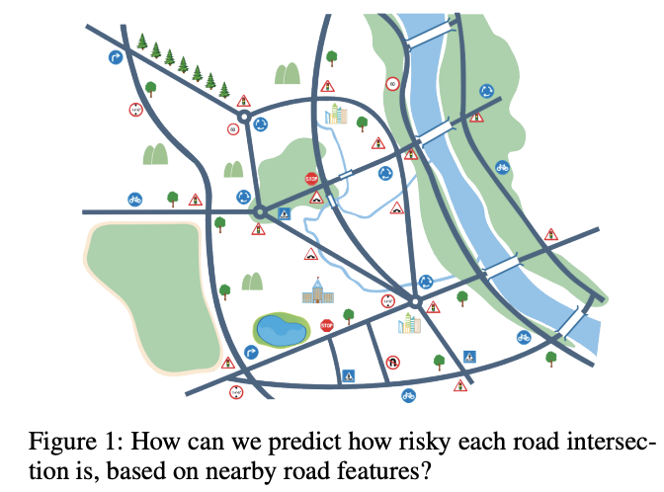
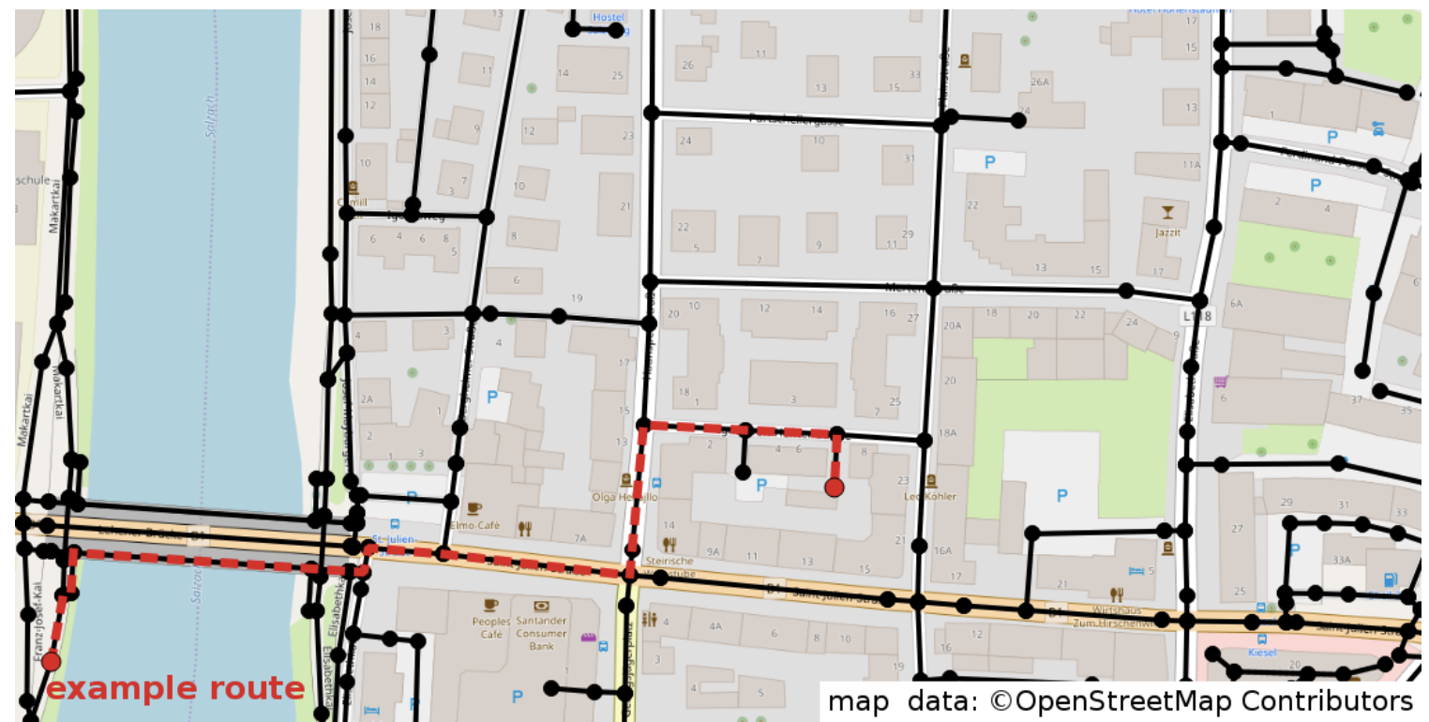
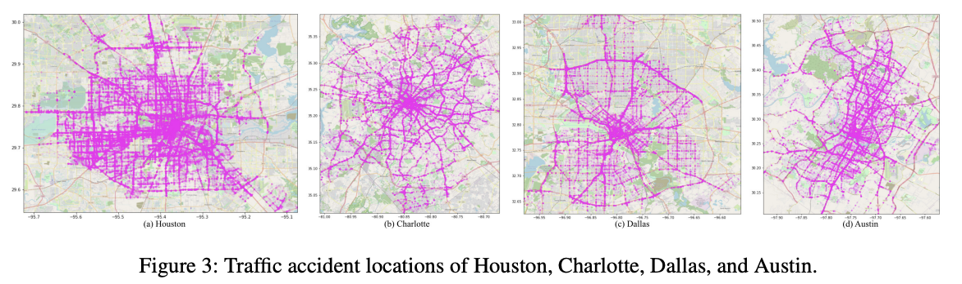
Graph Data: Traffic Networks
Notes:
Google maps – uses graph for shortest path routing

Slide 6


Overview: Graph Processing
Tasks
Graph Mining
Graph Learning
…
…
PageRank
Community Detection
Node / Graph Similarity
Node / Graph Prediction
Systems
Small Graph Processing
Large Graph Processing
Graph Databases
NetworkX
iGraph
Network
Notes:
PageRank is one of the most important graph mining algorithms – it is more like a family of algorithms, that can be adapted to all kinds of tasks, beyond a single algorithm

Slide 7
Today’s Plan
Graphs: Introduction
Simplified PageRank
Flow Formulation
Random Walk Formulation
PageRank (with Teleports)
Topic Sensitive PageRank
PageRank Implementation
Notes:
“Simplified” refers to PageRank with no teleport
(The standard meaning of “PageRank” does include the use of teleport)

Slide 8
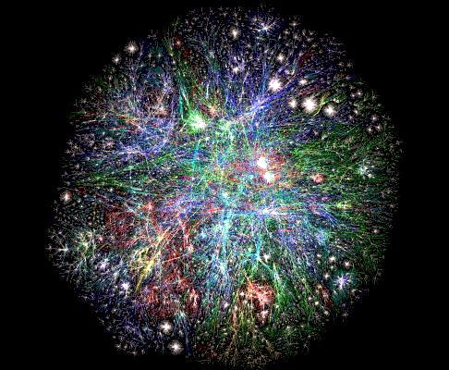
Web as a Graph
Web as a directed graph:
Nodes: Webpages
Edges: Hyperlinks
Graph of the World Wide Web (http://www.bordalierinstitute.com/ (The Bordalier Institute))
Notes:
Web graphs. In this chapter, we will use Web graph as an example.

Slide 9
PageRank: Ranking Pages on the Web
All web pages are not equally “important”: www.joe-schmoe.com vs. en.wikipedia.org
Measuring the importance of pages is necessary for many web-related tasks (e.g. search, recommendation)
PageRank-like methods are also used in many other applications (bioinformatics, etc.)
en.wikipedia.org
news.google.com
A
3.3
D
3.9
E
8.1
F
3.9
nus.edu.sg
1.6
1.6
1.6
1.6
1.6
Notes:
PageRank was very important to the success of google in its early days
In bioinformatics – GeneRank, ProteinRank

Slide 10
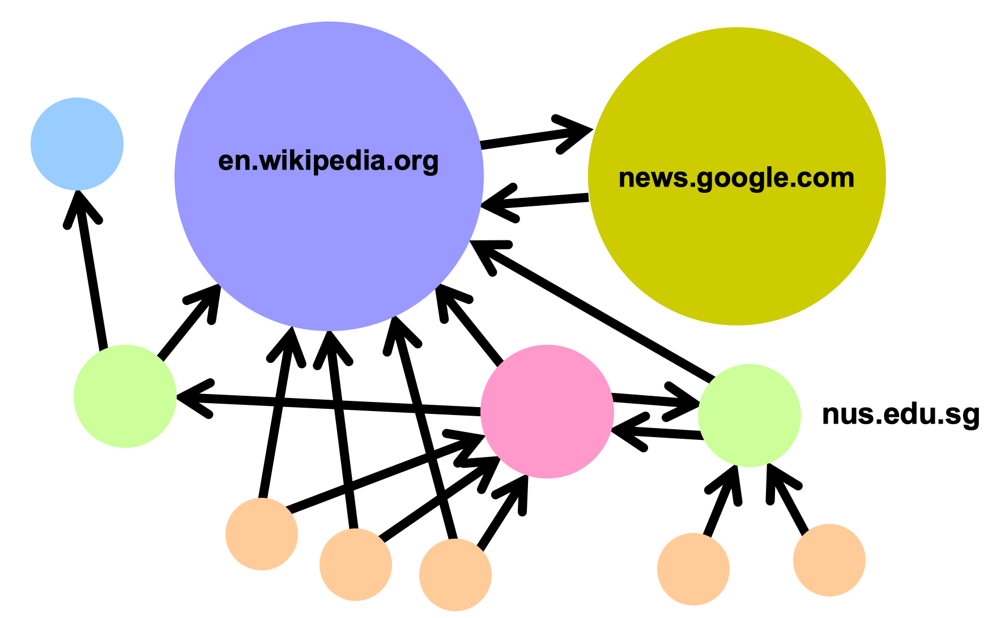
Links as Votes
Idea: Links as votes
Page is more important if it has more in-links
Assume that incoming links are harder to manipulate. For example, anyone can create an out-link from their page to en.wikipedia.edu, but it is hard to get en.wikipedia.edu to create a link to their page
Think of in-links as votes

Slide 11
Links as Votes
Think of in-links as votes
Naïve solution: What if we rank each page based on its number of in-links?
Problem: malicious user can create a huge number of ‘dummy' web pages, to link to their one page, to drive up its rank!
F
3.9
1.6
1.6
…
1.6
1.6

Slide 12
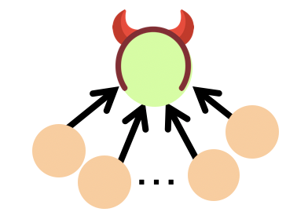
Links as Votes
Solution: make the number of ‘votes’ that a page has proportional to its own importance. Then, as long as the ‘dummy’ pages themselves have low importance, they will contribute little votes as well.
Links from important pages count more – recursive definition!
This is the main idea of PageRank, which recursively defines the importance of a page based on the importance of the pages linking to it
Low importance => low votes

Slide 13
Example: PageRank Scores
B
38.4
C
34.3
A
3.3
D
3.9
E
8.1
F
3.9
1.6
1.6
1.6
1.6
1.6
Notes:
The higher score means higher importance.

Slide 14
‘Voting’ Formulation
Each link’s vote is proportional to the importance of its source page
For each page j, define its “importance” (or rank) as r_{j}
If page j with importance r_{j} has n out-links, each link gets r_{j} / n votes
(Importance = r_{j})
j
r_{j}/3
r_{j}/3
r_{j}/3

Slide 15
‘Voting’ Formulation
Each link’s vote is proportional to the importance of its source page
For each page j, define its “importance” (or rank) as r_{j}
If page j with importance r_{j} has n out-links, each link gets r_{j} / n votes
Page j’s own importance is the sum of the votes on its in-links
Analogy: each page receives a certain amount of candies from its incoming neighbors. It distributes these candies evenly to its outgoing neighbors.
i
k
r_{j} = r_{i}/3 + r_{k}/4
r_{i}/3
r_{k}/4
(Importance = r_{j})
j
r_{j}/3
Importance of node j
r_{j}/3
r_{j}/3
Importance node j receives from its incoming edges

Slide 16
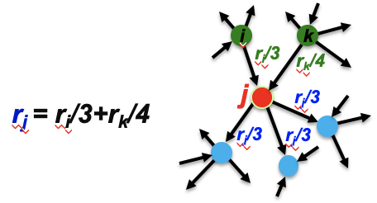
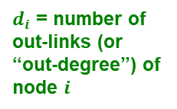
PageRank: The “Flow” Model
A “vote” from an important page is worth more
A page is important if it is pointed to by other important pages
Define a “rank” or importance r_{j} for page j
The web in 1839
r_{y} /2
y
r_{a} /2
r_{y} /2
r_{m}
a
m
r_{a} /2
$d_{i}$ = number of out-links (or “out-degree”) of node $i$
“Flow” equations:
r_{y} = r_{y} /2 + r_{a} /2
r_{a} = r_{y} /2 + r_{m}
r_{m} = r_{a} /2
Importance of j
Sum of importances of pages linking to j, each divided by number of out-links
“Simplified PageRank”

Slide 17
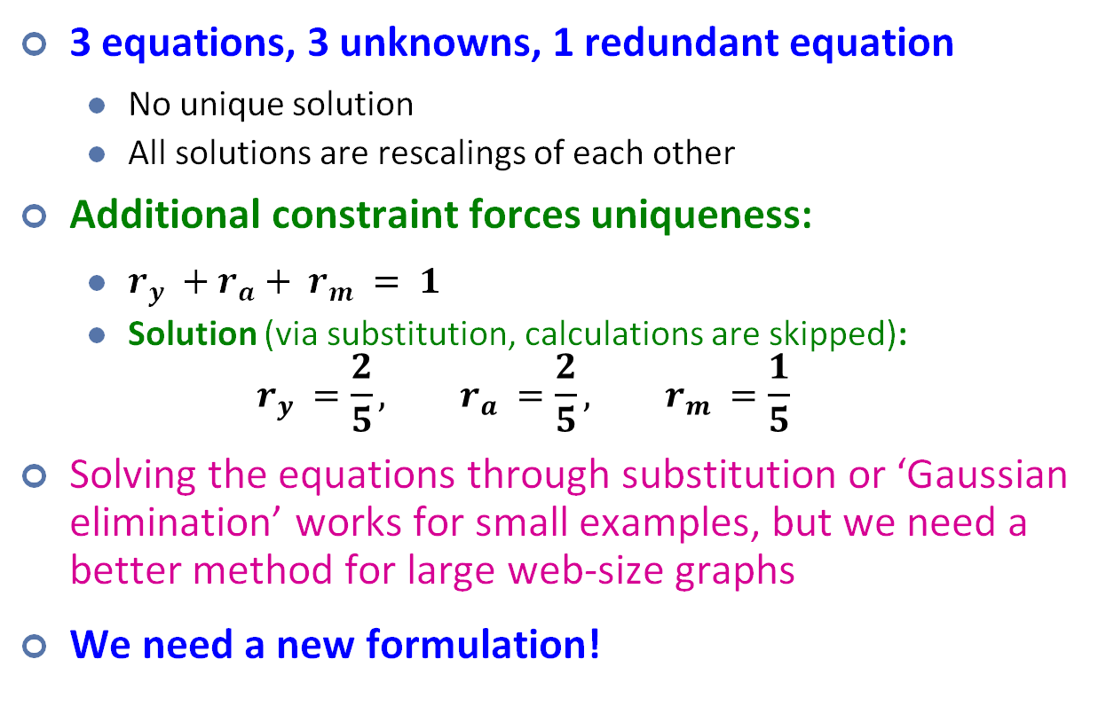
Solving the Flow Equations
The web in 1839
r_{y} /2
y
3 equations, 3 unknowns, 1 redundant equation
No unique solution
All solutions are rescalings of each other
Additional constraint forces uniqueness:
$r_{y} +r_{a}+ r_{m} = 1$
Solution (via substitution, calculations are skipped): $r_{y} =\frac{2}{5}, r_{a} =\frac{2}{5}, r_{m} =\frac{1}{5}$
Solving the equations through substitution or ‘Gaussian elimination’ works for small examples, but we need a better method for large web-size graphs
We need a new formulation!
r_{a} /2
r_{y} /2
r_{m}
a
m
r_{a} /2
Flow equations:
r_{y} = r_{y} /2 + r_{a} /2
r_{a} = r_{y} /2 + r_{m}
r_{m} = r_{a} /2

Slide 18
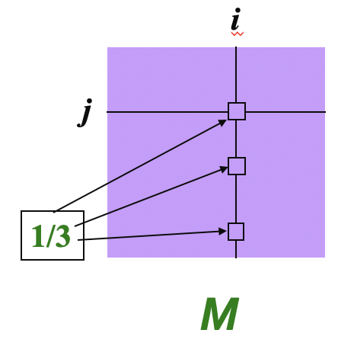
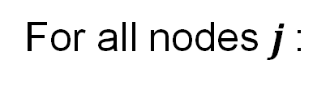
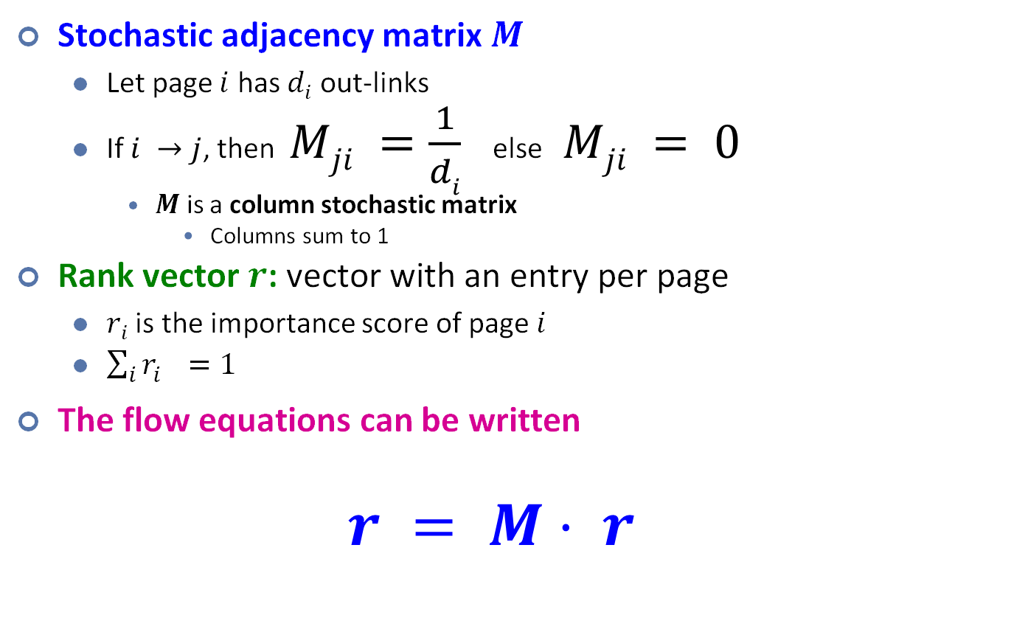
PageRank: Matrix Formulation
Stochastic adjacency matrix $M$
Let page $i$ has $di$ out-links
If $i →j$, then $Mji =\frac{1}{di}$ else $Mji = 0$
$M$ is a column stochastic matrix
Columns sum to 1
Rank vector $r$: vector with an entry per page
$ri$ is the importance score of page $i$
$\sum_{i}{r_{i}^{}=1}$
The flow equations can be written $r = M⋅ r$
i
j
This is equivalent to our earlier formulation:
For all nodes $j$:

Slide 19
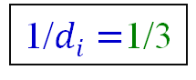
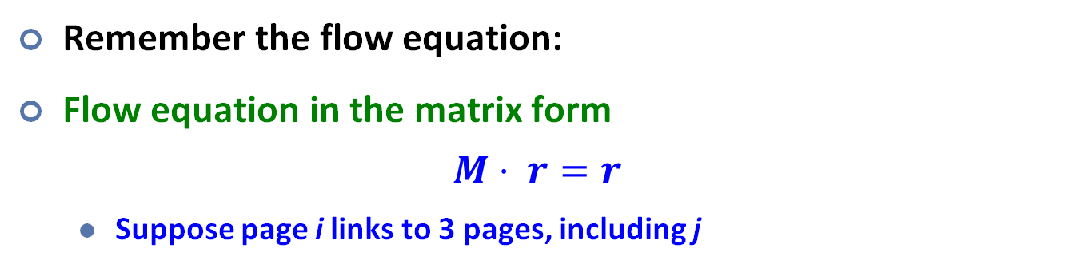
Why are the 2 formulations equivalent?
Remember the flow equation:
Flow equation in the matrix form
$$M⋅ r=r$$
Suppose page i links to 3 pages, including j
i
i
j
j
j
r_{j}
.
=
r_{i}
1/$di=$1/3
M
.
r
=
r

Slide 20
Example: Flow Equations & M
 | y | a | m
y | ½ | ½ | 0
a | ½ | 0 | 1
m | 0 | ½ | 0
y
a
m
r = M∙r
r_{y} = r_{y} /2 + r_{a} /2
r_{a} = r_{y} /2 + r_{m}
r_{m} = r_{a} /2
r_{y} ½ ½ 0 r_{y}
r_{a} = ½ 0 1 r_{a}
r_{m} 0 ½ 0 r_{m}
Notes:
This is an example by comparing the flow model and matrix model.

Slide 21
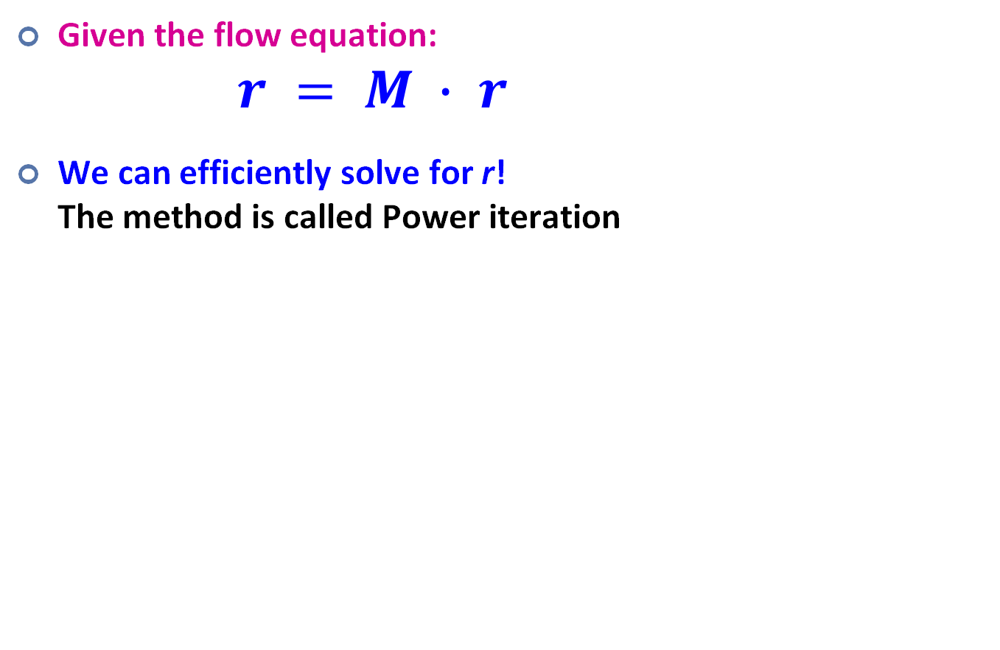
Solving the Flow Equations
Given the flow equation: $r = M ∙ r$
We can efficiently solve for r! The method is called Power iteration
Notes:
https://en.wikipedia.org/wiki/Eigenvalues_and_eigenvectors

Slide 22
Power Iteration Method
Given a web graph with n nodes, where the nodes are pages and edges are hyperlinks
Power iteration: a simple iterative scheme
Suppose there are N web pages
Initialize: r⁽⁰⁾ = [1/N,….,1/N]^{T}
Iterate: r^{(t+1)} = M ∙ r^{(t)}
Stop when |r^{(t+1)} – r^{(t)}|₁ < ε
Equivalent!
d_{i} …. out-degree of node i
|x|₁ = ∑_{1≤i≤N}|x_{i}| is the L1 norm
Can use any other vector norm, e.g., Euclidean
Intuitive interpretation of power iteration: each node starts with equal importance (of 1/N). During each step, each node passes its current importance along its outgoing edges, to its neighbors.
Notes:
https://en.wikipedia.org/wiki/Power_iteration

Slide 23
Power Iteration: Example
Power Iteration:
Suppose there are N web pages
Initialize: r⁽⁰⁾ = [1/N,….,1/N]^{T}
Iterate: r^{(t+1)} = M ∙ r^{(t)}
Stop when |r^{(t+1)} – r^{(t)}|₁ < ε
Example:
r_{y} 1/3 1/3 5/12 9/24 2/5
r_{a} = 1/3 3/6 1/3 11/24 … 2/5
r_{m} 1/3 1/6 3/12 1/6 1/5
y
 | y | a | m
y | ½ | ½ | 0
a | ½ | 0 | 1
m | 0 | ½ | 0
r_{y} = r_{y} /2 + r_{a} /2
r_{a} = r_{y} /2 + r_{m}
r_{m} = r_{a} /2
a
m
Iteration 0
Iteration 1
…
Notes:
Intuitive view of power iteration: each node passes importance to its neighbors
1/6 comes from importance passed from node a, split among its 2 neighbors

Slide 24
Today’s Plan
Graphs: Introduction
Simplified PageRank
Flow Formulation
Random Walk Formulation
PageRank (with Teleports)
Topic Sensitive PageRank
PageRank Implementation

Slide 25
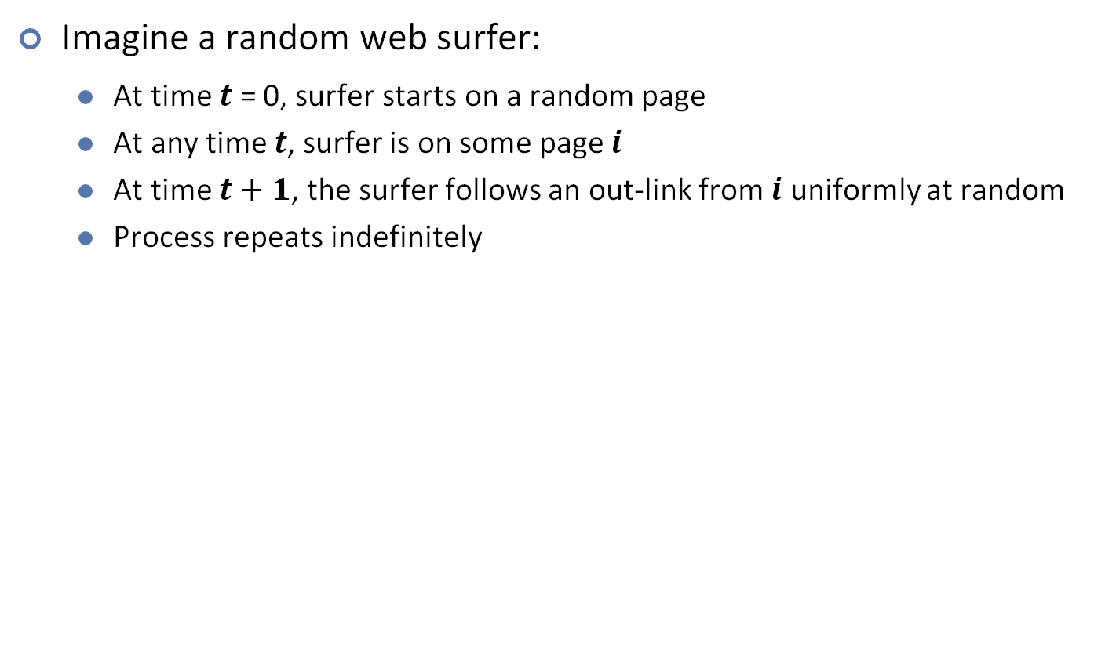
Random Walk Interpretation
Imagine a random web surfer:
At time $t$ = 0, surfer starts on a random page
At any time $t$, surfer is on some page $i$
At time $t+1$, the surfer follows an out-link from $i$ uniformly at random
Process repeats indefinitely
y
t = 0:
a
m

Slide 26
Random Walk Interpretation
Imagine a random web surfer:
At time $t$ = 0, surfer starts on a random page
At any time $t$, surfer is on some page $i$
At time $t+1$, the surfer follows an out-link from $i$ uniformly at random
Process repeats indefinitely
y
t = 1:
a
m

Slide 27
Random Walk Interpretation
Imagine a random web surfer:
At time $t$ = 0, surfer starts on a random page
At any time $t$, surfer is on some page $i$
At time $t+1$, the surfer follows an out-link from $i$ uniformly at random
Process repeats indefinitely
y
t = 2:
a
m

Slide 28
Random Walk Interpretation
Imagine a random web surfer:
At time $t$ = 0, surfer starts on a random page
At any time $t$, surfer is on some page $i$
At time $t+1$, the surfer follows an out-link from $i$ uniformly at random
Process repeats indefinitely
y
t = 3:
a
m

Slide 29
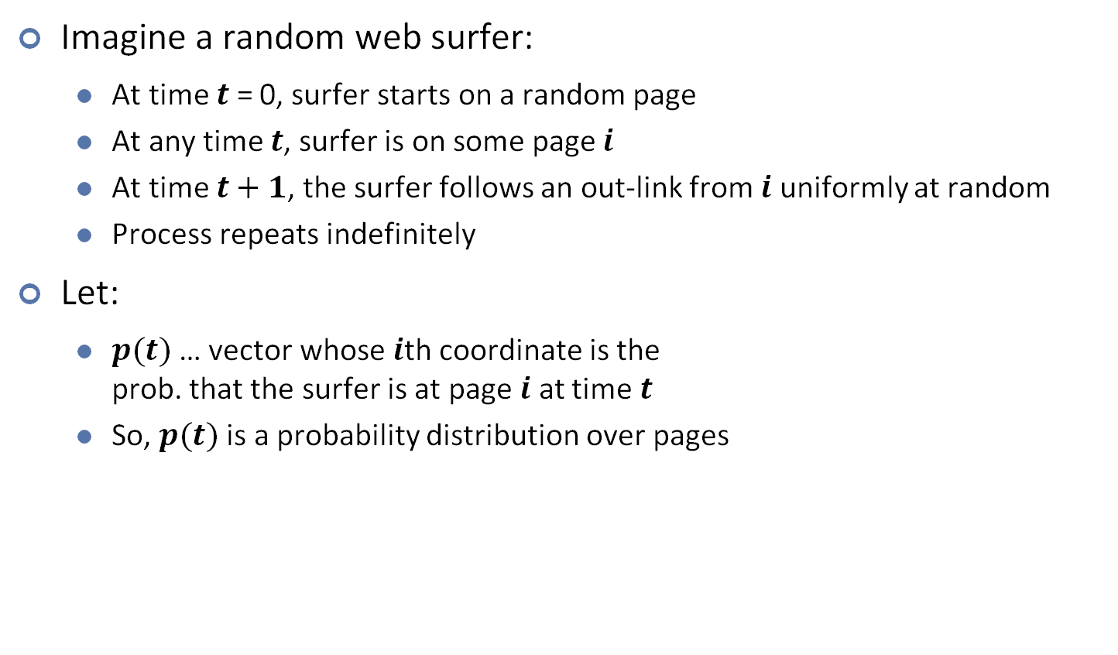
Random Walk Interpretation
Imagine a random web surfer:
At time $t$ = 0, surfer starts on a random page
At any time $t$, surfer is on some page $i$
At time $t+1$, the surfer follows an out-link from $i$ uniformly at random
Process repeats indefinitely
Let:
$p(t)$ … vector whose $i$th coordinate is the prob. that the surfer is at page $i$ at time $t$
So, $p(t)$ is a probability distribution over pages
p(t) where t = 0:
1/3
y
a
m
1/3
1/3

Slide 30

Random Walk Interpretation
Imagine a random web surfer:
At time $t$ = 0, surfer starts on a random page
At any time $t$, surfer is on some page $i$
At time $t+1$, the surfer follows an out-link from $i$ uniformly at random
Process repeats indefinitely
Let:
$p(t)$ … vector whose $i$th coordinate is the prob. that the surfer is at page $i$ at time $t$
So, $p(t)$ is a probability distribution over pages
p(t) where t = 1:
1/3
y
a
m
1/2
1/6

Slide 31
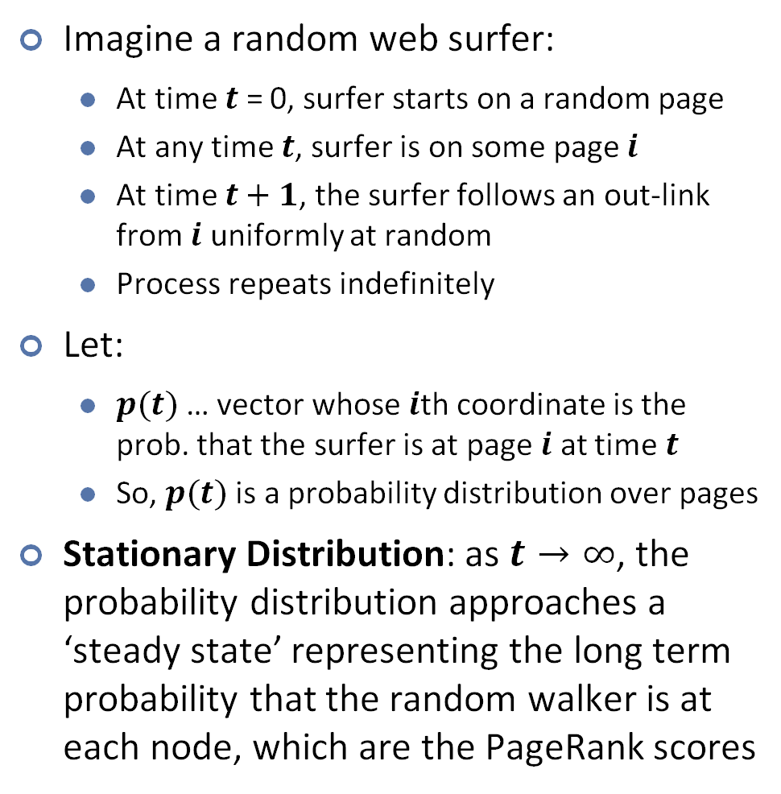
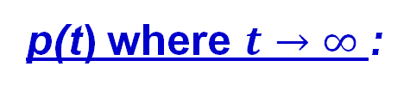
Random Walk Interpretation
Imagine a random web surfer:
At time $t$ = 0, surfer starts on a random page
At any time $t$, surfer is on some page $i$
At time $t+1$, the surfer follows an out-link from $i$ uniformly at random
Process repeats indefinitely
Let:
$p(t)$ … vector whose $i$th coordinate is the prob. that the surfer is at page $i$ at time $t$
So, $p(t)$ is a probability distribution over pages
Stationary Distribution: as $t→∞$, the probability distribution approaches a ‘steady state’ representing the long term probability that the random walker is at each node, which are the PageRank scores
p(t) where $t→∞$:
2/5
y
a
m
2/5
1/5

Slide 32
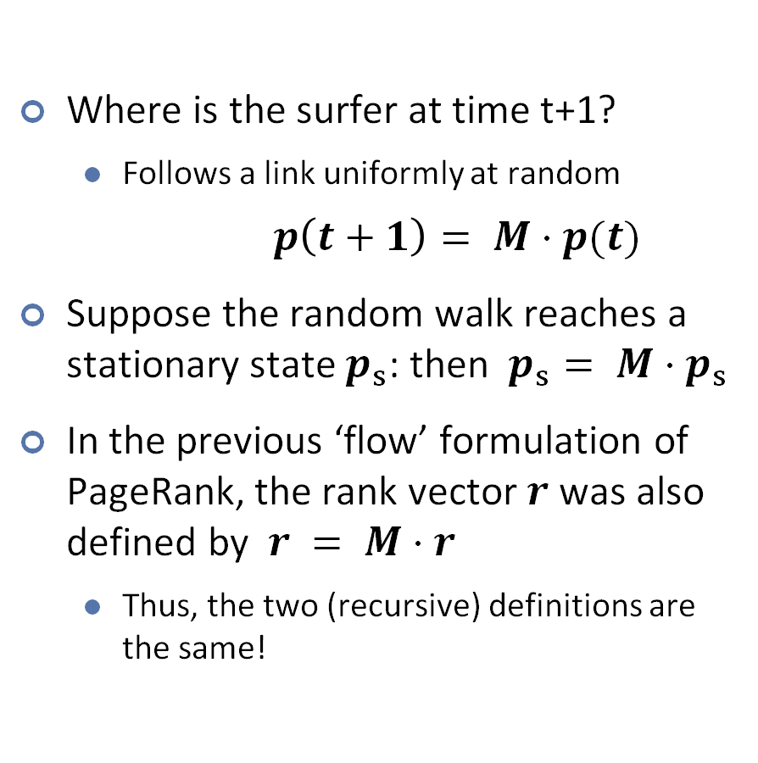
Equivalence between Random Walk and Flow Formulations
Where is the surfer at time t+1?
Follows a link uniformly at random
$p\left(t+1\right)= M⋅p(t)$
Suppose the random walk reaches a stationary state $p_{s}$: then $p_{s}= M⋅p_{s}$
In the previous ‘flow’ formulation of PageRank, the rank vector $r$ was also defined by $r = M⋅r$
Thus, the two (recursive) definitions are the same!
p(t) where $t→∞$:
2/5
y
a
m
2/5
1/5

Slide 33
Today’s Plan
Graphs: Introduction
Simplified PageRank
Flow Formulation
Random Walk Formulation
PageRank (with Teleports)
Topic Sensitive PageRank
PageRank Implementation

Slide 34
PageRank: Three Questions
Does this converge?
Does it converge to what we want?
Are results reasonable?
or
equivalently

Slide 35
Does this converge?
Answer: not always. Example:
r_{a} 1 0 1 0
r_{b} 0 1 0 1
a
b
=
Iteration 0, 1, 2, …

Slide 36
Does it converge to what we want?
Dead end
Answer: not always. 2 problems:
(1) Some pages are dead ends (have no out-links)
Random walk has “nowhere” to go to
Such pages cause importance to “leak out”
(2) Spider traps: (all out-links are within the group)
Random walk gets “stuck” in a trap
And eventually spider traps absorb all importance
Spider trap
Notes:
What are the problems?
One phenomena is called dead end. There may be some dead ends (which do not have out-links)… → importance leak out.
The other phenomena is called spider trap. All outgoing links are within the group. Thus, eventually, spider traps absorb all importance.

Slide 37
Problem 1: Dead Ends
Example:
r_{a} 1 0 0 0
r_{b} 0 1 0 0
a
b
=
Iteration 0, 1, 2, …

Slide 38
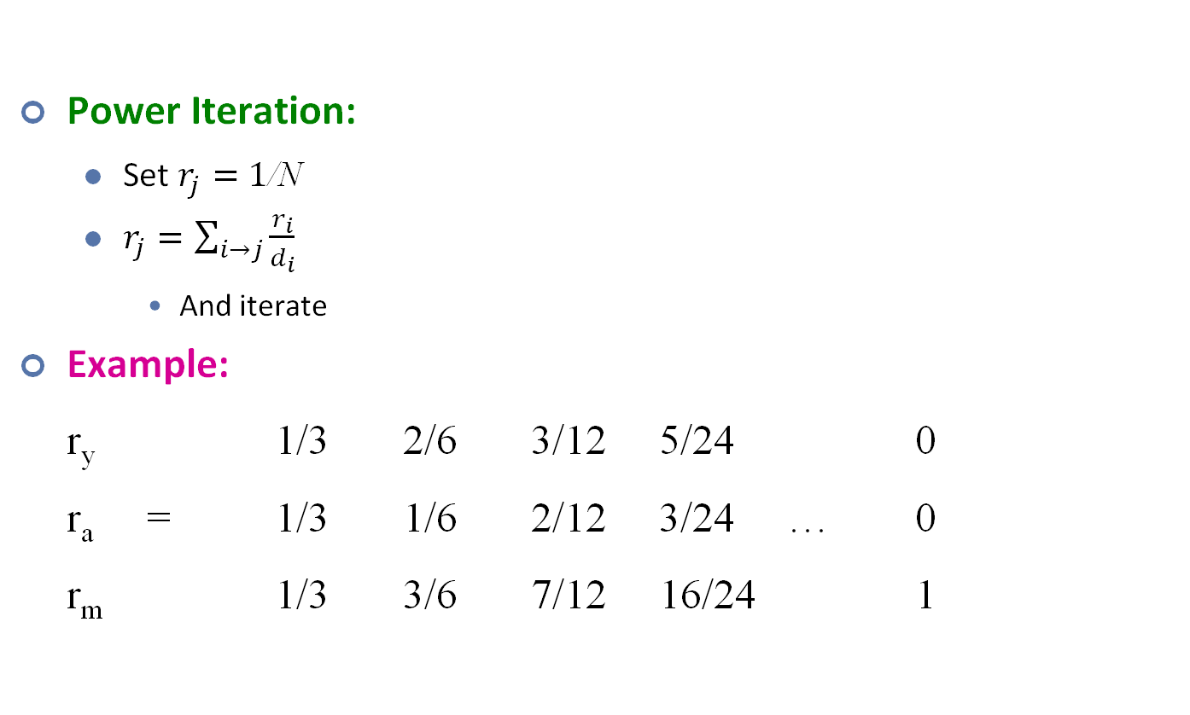
Problem 2: Spider Traps
Power Iteration:
Set $r_{j}=1$/N
$r_{j}=\sum_{i→j}{\frac{r_{i}}{d_{i}}}$
And iterate
Example:
r_{y} 1/3 2/6 3/12 5/24 0
r_{a} = 1/3 1/6 2/12 3/24 … 0
r_{m} 1/3 3/6 7/12 16/24 1
y
 | y | a | m
y | ½ | ½ | 0
a | ½ | 0 | 0
m | 0 | ½ | 1
a
m
m is a spider trap
r_{y} = r_{y} /2 + r_{a} /2
r_{a} = r_{y} /2
r_{m} = r_{a} /2 + r_{m}
Iteration 0, 1, 2, …
All the PageRank score gets “trapped” in node m.
Notes:
Let’s see one more example.

Slide 39
Solution: Teleports!
The Google solution for spider traps: At each time step, the random surfer has two options
With prob. β, follow a link at random
With prob. 1-β, jump to some random page
Common values for β are in the range 0.8 to 0.9
y
y
1−β
1−β
1−β
a
m
a
m

Slide 40
Solution: Teleports!
The Google solution for spider traps: At each time step, the random surfer has two options
With prob. β, follow a link at random
With prob. 1-β, jump to some random page
Common values for β are in the range 0.8 to 0.9
t = 0:
y
a
m

Slide 41
Solution: Teleports!
The Google solution for spider traps: At each time step, the random surfer has two options
With prob. β, follow a link at random
With prob. 1-β, jump to some random page
Common values for β are in the range 0.8 to 0.9
t = 1:
y
a
m

Slide 42
Solution: Teleports!
The Google solution for spider traps: At each time step, the random surfer has two options
With prob. β, follow a link at random
With prob. 1-β, jump to some random page
Common values for β are in the range 0.8 to 0.9
t = 2:
y
a
m

Slide 43
Solution: Teleports!
The Google solution for spider traps: At each time step, the random surfer has two options
With prob. β, follow a link at random
With prob. 1-β, jump to some random page
Common values for β are in the range 0.8 to 0.9
(teleported)
t = 3:
y
a
m

Slide 44
Solution: Teleports!
The Google solution for spider traps: At each time step, the random surfer has two options
With prob. β, follow a link at random
With prob. 1-β, jump to some random page
Common values for β are in the range 0.8 to 0.9
Conclusion: surfer will quickly teleport out of any spider trap
(teleported)
t = 3:
y
a
m

Slide 45
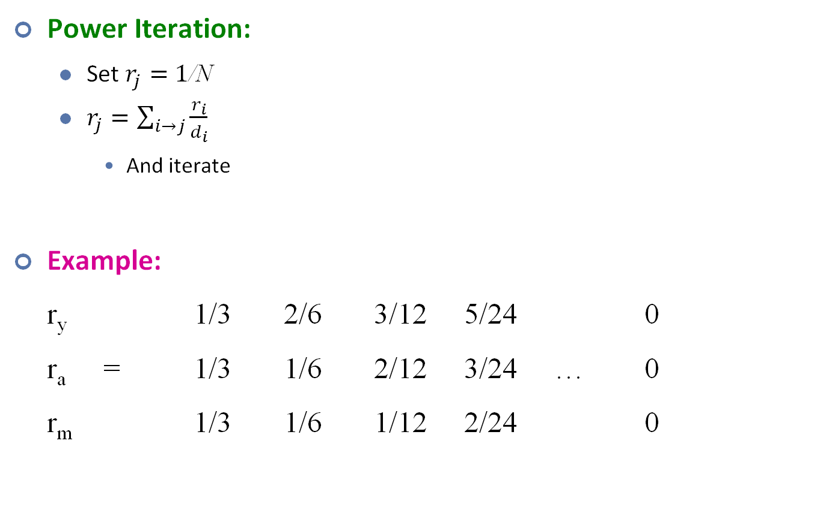
Problem: Dead Ends
Power Iteration:
Set $r_{j}=1$/N
$r_{j}=\sum_{i→j}{\frac{r_{i}}{d_{i}}}$
And iterate
Example:
r_{y} 1/3 2/6 3/12 5/24 0
r_{a} = 1/3 1/6 2/12 3/24 … 0
r_{m} 1/3 1/6 1/12 2/24 0
y
 | y | a | m
y | ½ | ½ | 0
a | ½ | 0 | 0
m | 0 | ½ | 0
a
m
r_{y} = r_{y} /2 + r_{a} /2
r_{a} = r_{y} /2
r_{m} = r_{a} /2
Iteration 0, 1, 2, …
Here the PageRank “leaks” out since the matrix is not stochastic.

Slide 46
Solution: If at a Dead End, Always Teleport
Teleports: Follow random teleport links with probability 1.0 from dead-ends
Equivalently, for each dead end m we can preprocess the random walk matrix M by making m connected to every node (including itself).
y
y
1−β
1−β
1
a
m
a
m
 | y | a | m
y | ½ | ½ | 0
a | ½ | 0 | 0
m | 0 | ½ | 0
 | y | a | m
y | ½ | ½ | ⅓
a | ½ | 0 | ⅓
m | 0 | ½ | ⅓
M =

Slide 47
Why Teleports Solve the Problem?
Why are dead-ends and spider traps a problem and why do teleports solve the problem?
Spider-traps cause random walker to get stuck in them, absorbing all importance
Solution: Never get stuck in a spider trap by teleporting out of it in a finite number of steps
Dead-ends cause importance to “leak” out of the system
The matrix is not column stochastic
Solution: Make matrix column stochastic by always teleporting when at a dead end

Slide 48
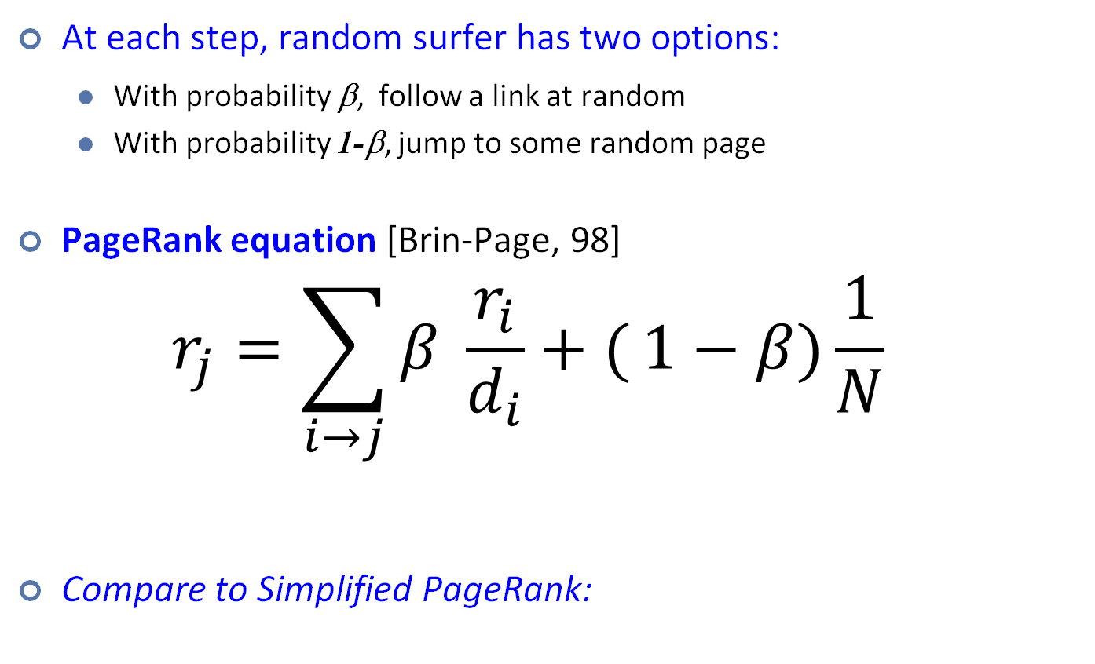
Random Teleport: Equations
At each step, random surfer has two options:
With probability β, follow a link at random
With probability 1-β, jump to some random page
PageRank equation [Brin-Page, 98] $r_{j}=\sum_{i→j}{β \frac{r_{i}}{d_{i}}+(}1−β)\frac{1}{N}$
Compare to Simplified PageRank:
d_{i} … out-degree of node i
Same as simplified PageRank
Teleport term
(If any dead ends exist, we assume that we have preprocessed by adding connections from them to every other node)

Slide 49
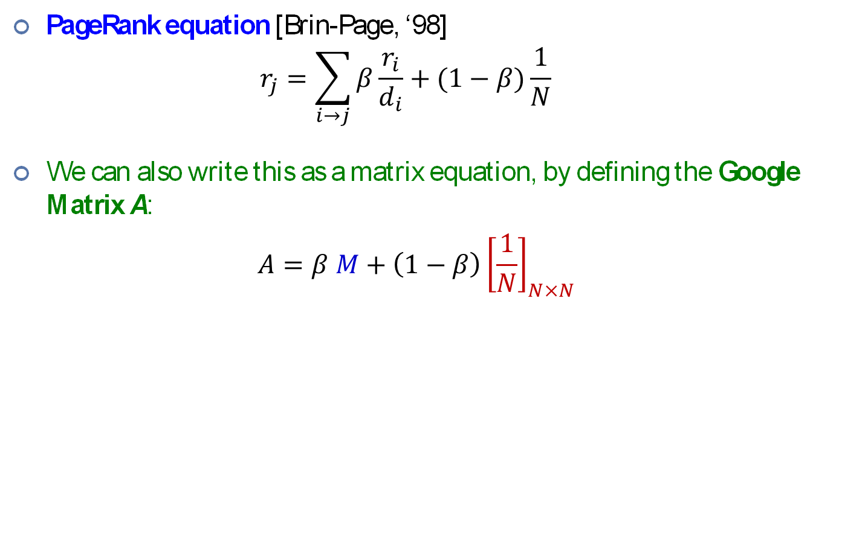
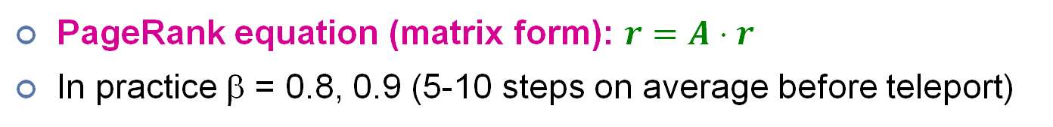
The Google Matrix
PageRank equation [Brin-Page, ‘98] $r_{j}=\sum_{i→j}{β\frac{r_{i}}{d_{i}}}+(1−β)\frac{1}{N}$
We can also write this as a matrix equation, by defining the Google Matrix A:
$$A=β M+\left(1−β\right){\left[\frac{1}{N}\right]}_{N×N}$$
N by N matrix where all entries are 1/N
y
y
a
m
y
a
m
½ ½ 0
½ 0 1
0 ½ 0
⅓ ⅓ ⅓
⅓ ⅓ ⅓
⅓ ⅓ ⅓
a
m
PageRank equation (matrix form): $r=A⋅r$
In practice β = 0.8, 0.9 (5-10 steps on average before teleport)
Notes:
If we put it in matrix form, the power iteration still works.

Slide 50
Some Problems with Page Rank
Measures generic popularity of a page
Doesn’t consider popularity based on specific topics
Solution: Topic-Specific PageRank
Uses a single measure of importance
Other models of importance
Solution: Hubs-and-Authorities
Susceptible to Link spam
Artificial link topographies created in order to boost page rank
Solution: TrustRank

Slide 51
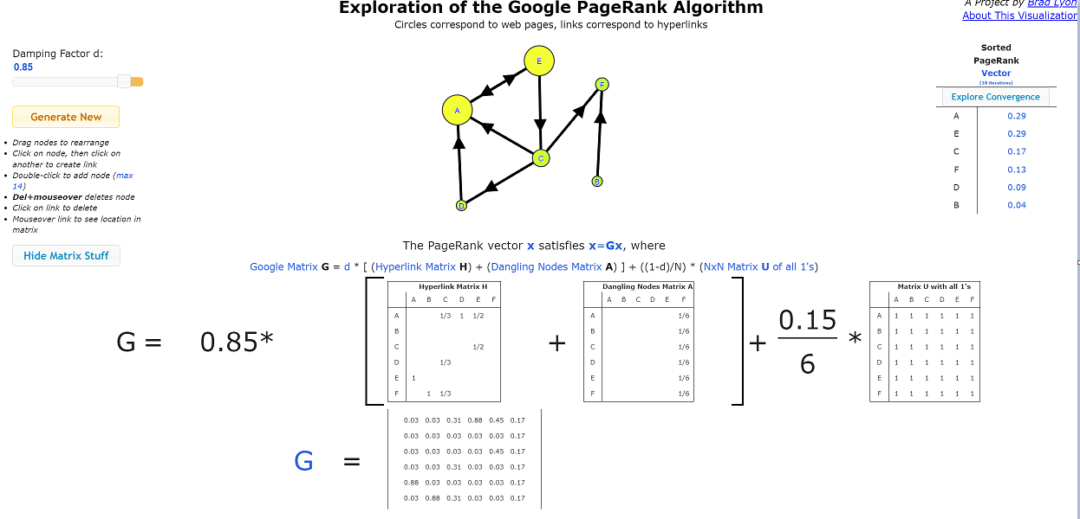
PageRank: Animation
https://www.learnforeverlearn.com/pagerank/

Slide 52
Today’s Plan
Graphs: Introduction
Simplified PageRank
Flow Formulation
Random Walk Formulation
PageRank (with Teleports)
Topic Specific PageRank
PageRank Implementation

Slide 53
Topic-Specific PageRank
Instead of generic popularity, can we measure popularity within a topic?
Goal: Evaluate Web pages not just according to their popularity, but by how close they are to a particular topic, e.g. “sports” or “history”
Allows search queries to be answered based on interests of the user
Example: Query “Trojan” wants different pages depending on whether you are interested in sports, history and computer security
Notes:
Personalized search.

Slide 54

Topic-Specific PageRank
Random walker has a small probability of teleporting at any step
Teleport can go to:
Standard PageRank: Any page with equal probability
To avoid dead-end and spider-trap problems
Topic Specific PageRank: A topic-specific set of “relevant” pages (teleport set)
Idea: Bias the random walk
When random walker teleports, it picks a page from a set S
S contains only pages that are relevant to the topic
E.g., Open Directory (DMOZ) pages for a given topic/query
For each teleport set S, we get a different vector r_{S}
Notes:
Teleport set: a topic-specific set of relevant pages (for example, sport pages).
For each teleport set S, we get a different vector r_{S} → for different topics.

Slide 55
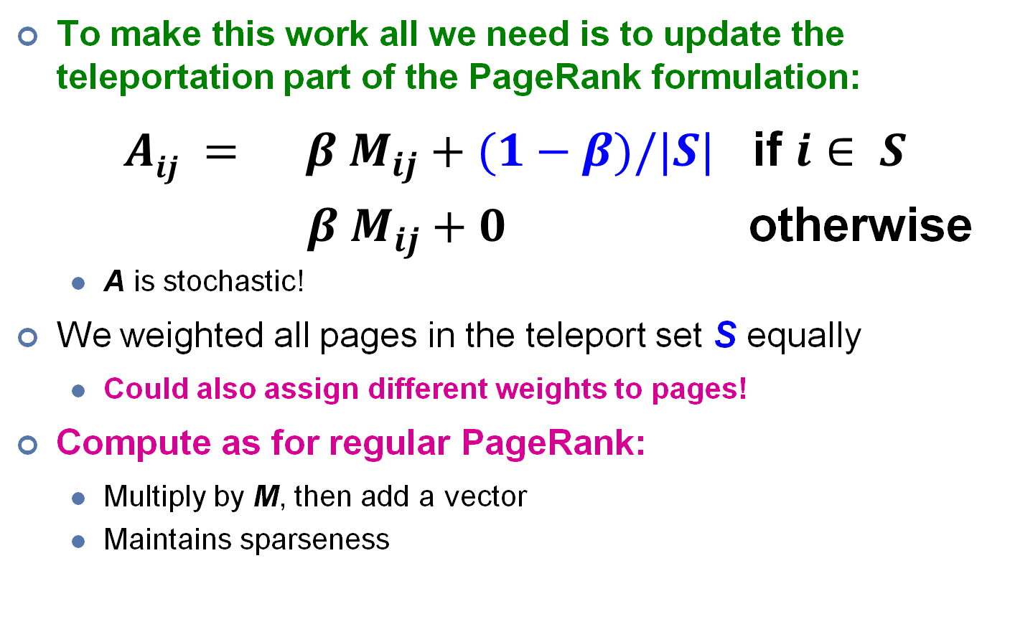
Matrix Formulation
To make this work all we need is to update the teleportation part of the PageRank formulation:
$Aij = β M_{ij}+(1−β)/|S|$ if $i∈ S$
$β M_{ij}+0$ otherwise
A is stochastic!
We weighted all pages in the teleport set S equally
Could also assign different weights to pages!
Compute as for regular PageRank:
Multiply by M, then add a vector
Maintains sparseness

Slide 56
Example: Topic-Specific PageRank
Suppose S = {1}, β = 0.8
0.2
0.5
1
Node Iteration
0 1 2 … stable
1 0.25 0.4 0.28 0.294
2 0.25 0.1 0.16 0.118
3 0.25 0.3 0.32 0.327
4 0.25 0.2 0.24 0.261
0.4
0.5
0.4
1
2
3
0.8
1
1
0.8
0.8
4
S={1,2,3,4}, β=0.8:
r=[0.13, 0.10, 0.39, 0.36]
S={1,2,3} , β=0.8:
r=[0.17, 0.13, 0.38, 0.30]
S={1,2} , β=0.8:
r=[0.26, 0.20, 0.29, 0.23]
S={1} , β=0.8:
r=[0.29, 0.11, 0.32, 0.26]
Probabilities (no teleport)
S={1}, β=0.9:
r=[0.17, 0.07, 0.40, 0.36]
S={1} , β=0.8:
r=[0.29, 0.11, 0.32, 0.26]
S={1}, β=0.7:
r=[0.39, 0.14, 0.27, 0.19]
Probabilities (with teleport)
Notes:
Beta=0.8, and teleport to S with probability of 0.2. S includes 1 only in this example.
As beta decreases, the probability of jumping to S becomes larger. Thus, the rank of vertex 1 increases.
As S set decreases, more weight is given to vertex 1.

Slide 57
Discovering the Topic Vector S
Create different PageRanks for different topics
The 16 DMOZ top-level categories:
arts, business, sports,…
Which topic ranking to use?
User can pick from a menu
Classify query into a topic
Can use the context of the query
E.g., query is launched from a web page talking about a known topic
History of queries e.g., “basketball” followed by “Jordan”
User context, e.g., user’s bookmarks, …
Notes:
Which topic ranking to use?
There are many possibilities.

Slide 58
Today’s Plan
Graphs: Introduction
Simplified PageRank
Flow Formulation
Random Walk Formulation
PageRank with Teleports
Topic Sensitive PageRank
PageRank Implementation

Slide 59
Characteristics of Graph Algorithms
What are some common features of graph algorithms?
Local computations at each vertex
Passing messages to other vertex
Think like a vertex: algorithms are implemented from the view of a single vertex, performing one iteration based on messages from its neighbor
Similar to MapReduce, the user only implements a simple function, compute(), that describes the algorithm’s behavior at one vertex, in one step.
The framework abstracts away the scheduling / implementation details.
i
k
r_{i}/3
r_{k}/4
j
r_{j}/3
r_{j}/3
r_{j}/3
Notes:
There are some common patterns.
Challenges: large scale, random accesses

Slide 60
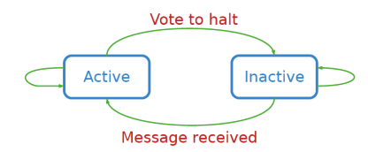
Pregel: Computational Model
Computation consists of a series of supersteps
In each superstep, the framework invokes a user-defined function, compute(), for each vertex (conceptually in parallel)
compute() specifies behavior at a single vertex v and a superstep s:
It can read messages sent to v in superstep s -1;
It can send messages to other vertices that will be read in superstep s + 1;
It can read or write the value of v and the value of its outgoing edges (or even add or remove edges)
Termination:
A vertex can choose to deactivate itself
Is “woken up” if new messages received
Computation halts when all vertices are inactive
Source: Malewicz et al. (2010) Pregel: A System for Large-Scale Graph Processing. SIGMOD.
Notes:
https://en.wikipedia.org/wiki/Bulk_synchronous_parallel
The Bulk Synchronous Parallel (BSP) abstract computer is a bridging model for designing parallel algorithms. It serves a purpose similar to the Parallel Random Access Machine (PRAM) model. BSP differs from PRAM by not taking communication and synchronization for granted. An important part of analyzing a BSP algorithm rests on quantifying the synchronization and communication needed. The BSP model was developed by Leslie Valiant of Harvard University during the 1980s. Leslie visited NUS in Jan 2017.

Slide 61
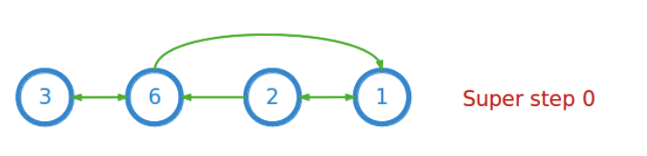
Example: Computing Max Value
Task: compute the maximum over the values in the vertices in this graph:
Summary of approach:
Each vertex repeatedly sends its current value to its neighbors (as “messages”). Then each vertex updates its value to the maximum over its own value, and all the messages it receives. This process continues until all vertex values stop changing.
Notes:
The computation is sync at each superstep.
Figure 2 illustrates these concepts using a simple example: given a strongly connected graph where each vertex contains
a value, it propagates the largest value to every vertex. In each superstep, any vertex that has learned a larger value
from its messages sends it to all its neighbors. When no further vertices change in a superstep, the algorithm terminates.
Maximum Value Example. Dotted lines are messages. Shaded vertices have voted to halt.

Slide 62
Example: Computing Max Value
Compute(v, messages):
changed = False
for m in messages:
if v.getValue() < m:
v.setValue(m)
changed = True
if changed:
for each outneighbor w:
sendMessage(w, v.getValue())
else:
voteToHalt()
Notes:
The computation is sync at each superstep.
Figure 2 illustrates these concepts using a simple example: given a strongly connected graph where each vertex contains
a value, it propagates the largest value to every vertex. In each superstep, any vertex that has learned a larger value
from its messages sends it to all its neighbors. When no further vertices change in a superstep, the algorithm terminates.
Maximum Value Example. Dotted lines are messages. Shaded vertices have voted to halt.

Slide 63
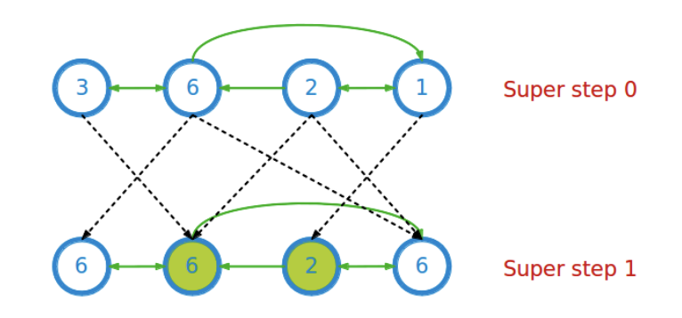
Example: Computing Max Value
Compute(v, messages):
changed = False
for m in messages:
if v.getValue() < m:
v.setValue(m)
changed = True
if changed:
for each outneighbor w:
sendMessage(w, v.getValue())
else:
voteToHalt()
Voting to halt
Notes:
The computation is sync at each superstep.
Figure 2 illustrates these concepts using a simple example: given a strongly connected graph where each vertex contains
a value, it propagates the largest value to every vertex. In each superstep, any vertex that has learned a larger value
from its messages sends it to all its neighbors. When no further vertices change in a superstep, the algorithm terminates.
Maximum Value Example. Dotted lines are messages. Shaded vertices have voted to halt.

Slide 64
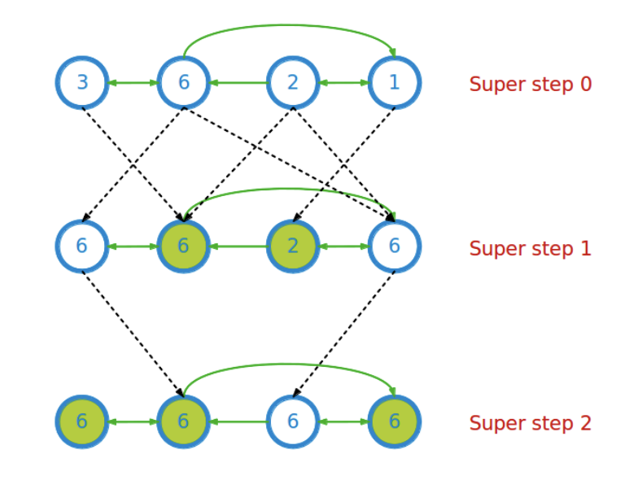
Example: Computing Max Value
Compute(v, messages):
changed = False
for m in messages:
if v.getValue() < m:
v.setValue(m)
changed = True
if changed:
for each outneighbor w:
sendMessage(w, v.getValue())
else:
voteToHalt()
Notes:
The computation is sync at each superstep.
Figure 2 illustrates these concepts using a simple example: given a strongly connected graph where each vertex contains
a value, it propagates the largest value to every vertex. In each superstep, any vertex that has learned a larger value
from its messages sends it to all its neighbors. When no further vertices change in a superstep, the algorithm terminates.
Maximum Value Example. Dotted lines are messages. Shaded vertices have voted to halt.

Slide 65
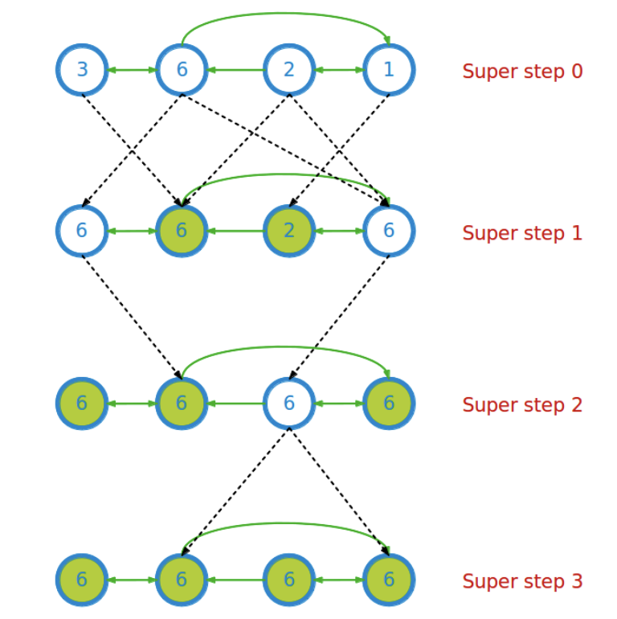
Example: Computing Max Value
Compute(v, messages):
changed = False
for m in messages:
if v.getValue() < m:
v.setValue(m)
changed = True
if changed:
for each outneighbor w:
sendMessage(w, v.getValue())
else:
voteToHalt()
Notes:
The computation is sync at each superstep.
Figure 2 illustrates these concepts using a simple example: given a strongly connected graph where each vertex contains
a value, it propagates the largest value to every vertex. In each superstep, any vertex that has learned a larger value
from its messages sends it to all its neighbors. When no further vertices change in a superstep, the algorithm terminates.
Maximum Value Example. Dotted lines are messages. Shaded vertices have voted to halt.

Slide 66
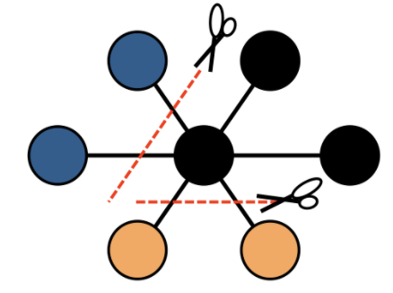
Pregel: Implementation
Master & workers architecture
Vertices are hash partitioned (by default) and assigned to workers (“edge cut”)
Each worker maintains the state of its portion of the graph in memory
Computations happen in memory
In each superstep, each worker loops through its vertices and executes compute()
Messages from vertices are sent, either to vertices on the same worker, or to vertices on different workers (buffered locally and sent as a batch to reduce network traffic)
Worker 1
Worker 2
Worker 3
Notes:
Heartbeat to check whether a machine is alive.
Checkpoint: have a snapshot
Revert: reverse the computation and restore to a certain snapshot.

Slide 67
Pregel: Implementation
Fault tolerance
Checkpointing to persistent storage
Failure detected through heartbeats
Corrupt workers are reassigned and reloaded from checkpoints
Notes:
Heartbeat to check whether a machine is alive.
Checkpoint: have a snapshot
Revert: reverse the computation and restore to a certain snapshot.

Slide 68
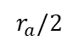
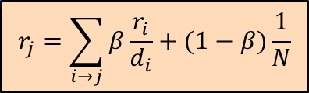
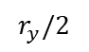
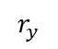
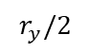
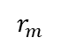
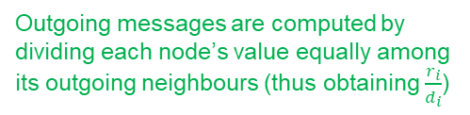
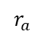
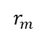
PageRank in Pregel
Outgoing messages are computed by dividing each node’s value equally among its outgoing neighbours (thus obtaining $\frac{r_{i}}{d_{i}}$)
Node’s current values, computed by summing messages from the previous Superstep and computing the PageRank update equation below.
Compute()
$$r_{y}$$
$$r_{y}/2$$
y
y
y
$$r_{a}/2$$
$$r_{y}/2$$
Compute()
$$r_{m}$$
$$r_{a}/2$$
a
m
a
m
a
m
Compute()
$$r_{a}$$
$$r_{m}$$
Superstep 1:
Invoke Compute()
Superstep 1:
Aggregate messages from neighbors to compute PageRank update
Superstep 1:
Send message to outgoing neighbors
$$r_{j}=\sum_{i→j}{β\frac{r_{i}}{d_{i}}}+(1−β)\frac{1}{N}$$
Repeat this execution till Superstep reaches 30

Slide 69
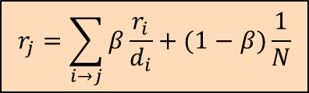
PageRank in Pregel
class PageRankVertex : public Vertex<double, void, double> {
public:
virtual void Compute(MessageIterator* msgs) {
if (superstep() >= 1) {
double sum = 0;
for (; !msgs->Done(); msgs->Next())
sum += msgs->Value();
*MutableValue() = 0.15 / NumVertices() + 0.85 * sum;
}
if (superstep() < 30) {
const int64 n = GetOutEdgeIterator().size();
SendMessageToAllNeighbors(GetValue() / n);
} else {
VoteToHalt();
}
}
};
Compute sum of incoming messages
PageRank update
$$r_{j}=\sum_{i→j}{β\frac{r_{i}}{d_{i}}}+(1−β)\frac{1}{N}$$
Send outgoing messages
Stop after fixed no. of iterations
Note: this algorithm implicitly assumes that the nodes’ values (*MutableValue()) have been correctly initialized based on the initialization scheme that the user wants. In practice, you would generally do the initialization during superstep 0.
Source: Malewicz et al. (2010) Pregel: A System for Large-Scale Graph Processing. SIGMOD.

Slide 70
Other Graph Processing Project
Giraph
An open-source implementation of Pregel by Facebook
Spark GraphX / GraphFrame
Extends RDDs to Resilient Distributed Property Graphs
Join Vertex Table and Edge Table to capture the relationships
See details in Appendix
Neo4j
Graph database + Graph processing
SQL like interface: Cypher Query Language

Slide 71
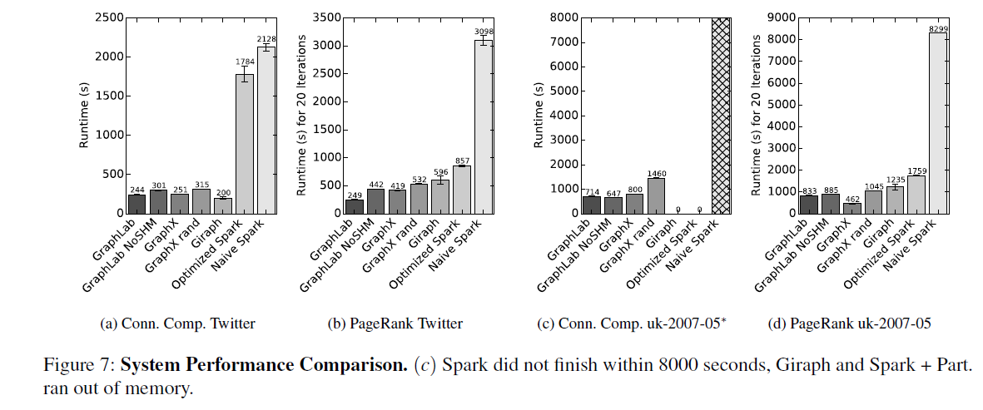
Performance Comparison
GraphX Paper 2015
GraphX can achieve performance parity compared with specialized graph systems
GraphX: Graph Processing in a Distributed Dataflow Framework, 2015

Slide 72
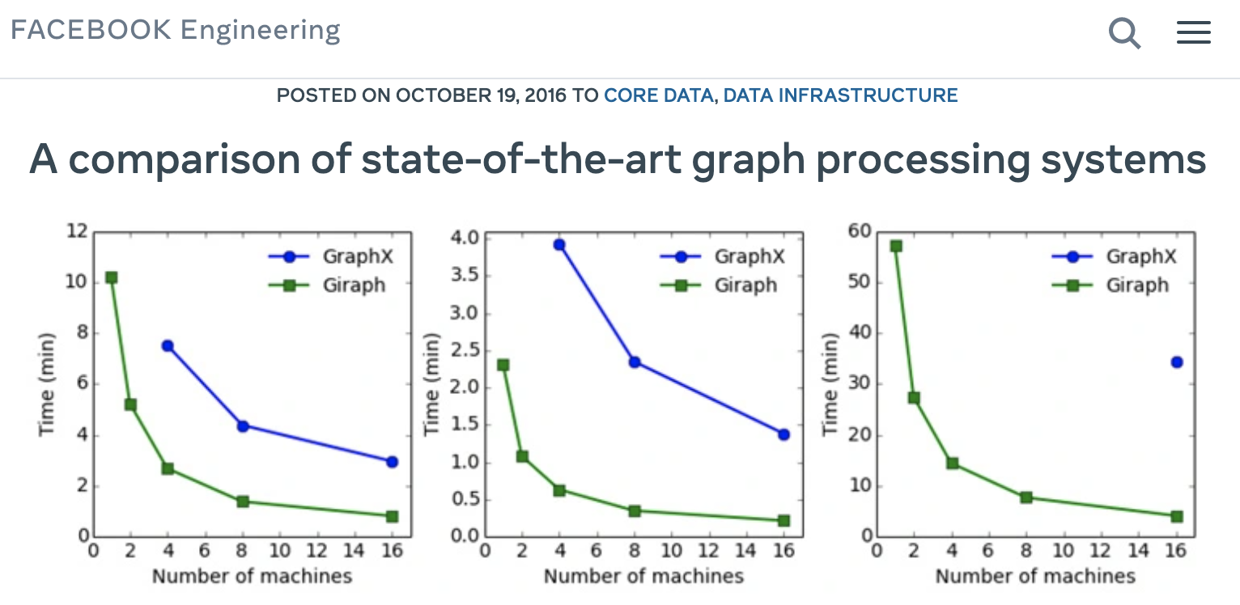
Performance Comparison
Facebook 2016
Giraph: an open source implementation of Pregel by Facebook
Efficiency Comparison (on ~ trillion-scale Facebook social graph)
Notes:
https://engineering.fb.com/2016/10/19/core-data/a-comparison-of-state-of-the-art-graph-processing-systems/#:~:text=Giraph%20is%20more%20memory%2Defficient,making%20it%20more%20efficient%20overall.

Slide 73
Acknowledgements
CS4225 slides by He Bingsheng and Bryan Hooi
Claudia Hauff - Big Data Processing (https://chauff.github.io/documents/bdp/graph_giraph.pdf) mmds.org – Mining of Massive Datasets - Jure Leskovec, Anand Rajaraman, Jeff Ullman
https://jakobmiksch.eu/post/openstreetmap_routing/
https://www.edrawmax.com/online-map-maker.html
https://learnforeverlearn.com/pagerank/
https://neo4j.com/

Slide 74
Appendix

Slide 75
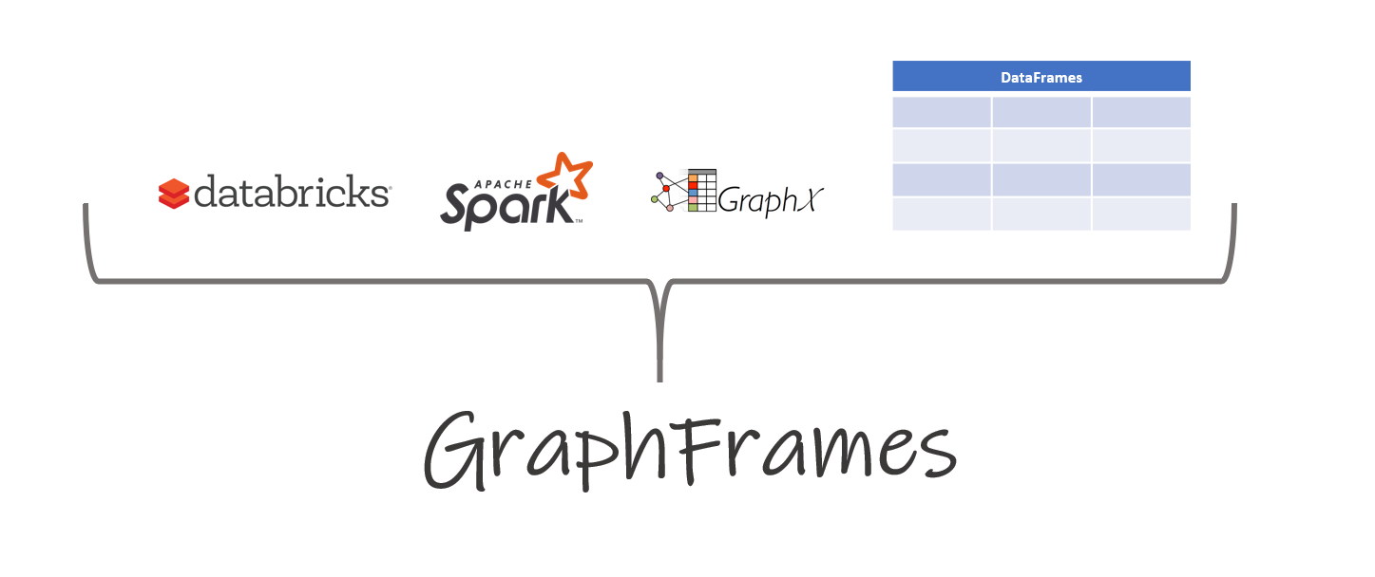
Notes:
An open-source system

Slide 76
Spark for Graphs
Spark is more efficient in iterative computation than Hadoop
Integration of record-oriented and graph-oriented processing
GraphX: Extends RDDs to Resilient Distributed Property Graphs
Property Graphs:
Present different views of the graph (vertices, edges, triplets)
Support map-like operations
Support distributed Pregel-like aggregations
Graphframe: Extends GraphX to provide a DataFrame API and support for Spark’s different language bindings
Notes:
http://spark.apache.org/docs/latest/graphx-programming-guide.html
https://graphframes.github.io/graphframes/docs/_site/index.html

Slide 77
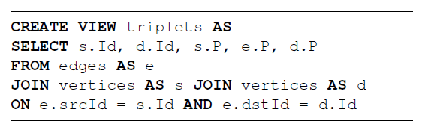
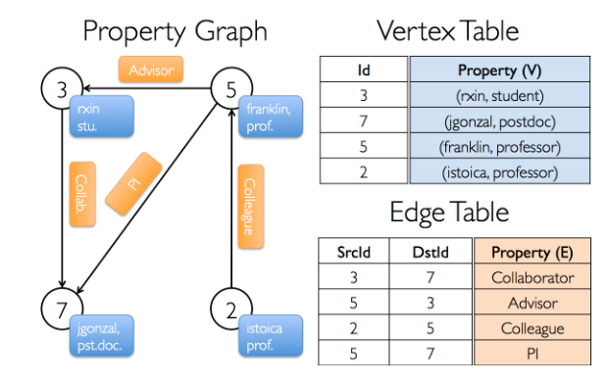
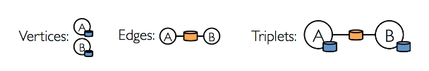

Spark Implementation on weighted pagerank
weighted page rank algorithm: PR = 0.15+0.85*sum(PR*weight)
Stage 1: Join
Stage 2: Group-By
https://spark.apache.org/docs/latest/graphx-programming-guide.html
Notes:
Using weighted page rank algorithm: PR = 0.15+0.85*sum(PR*weight)
With 85% of chance, the user will proceed through a hyperlink in the page;
With 15% of chance, the user will stay in the current page.

Slide 78


Spark uses Vertex Cut to partition the graph

Slide 79

Practical 4: Graph Analytics using Spark Graphframes

